Slide 1
ePoster Suppliments

Slide 2
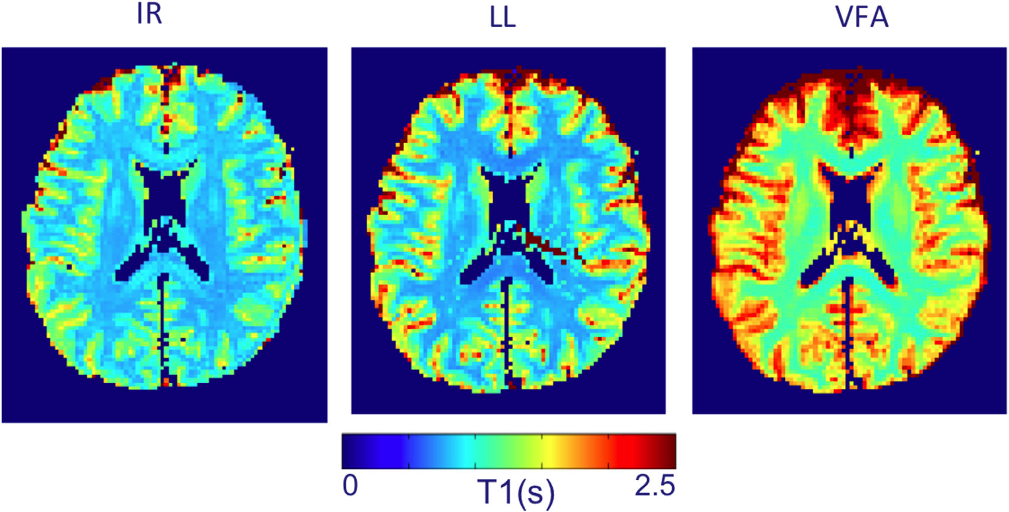

Slide 3
 | Stanisz, Odrobina et al. 2005 | Zhu and Penn 2005 | Cheng and Wright 2006 | Deoni, Peters et al. 2005 | Shin, Gu et al. 2009 | Preibisch and Deichmann 2009 | Gai and Butman 2009
IR | 1084 (45) | 690-810 |  | 1000-1100 | 943 (57) | 800-940
LL |  |  |  |  | 964 (116) |  | 755 (10)
VFA |  |  | 1084 (79) | 1000-1100 |  | 900-1020

Slide 4
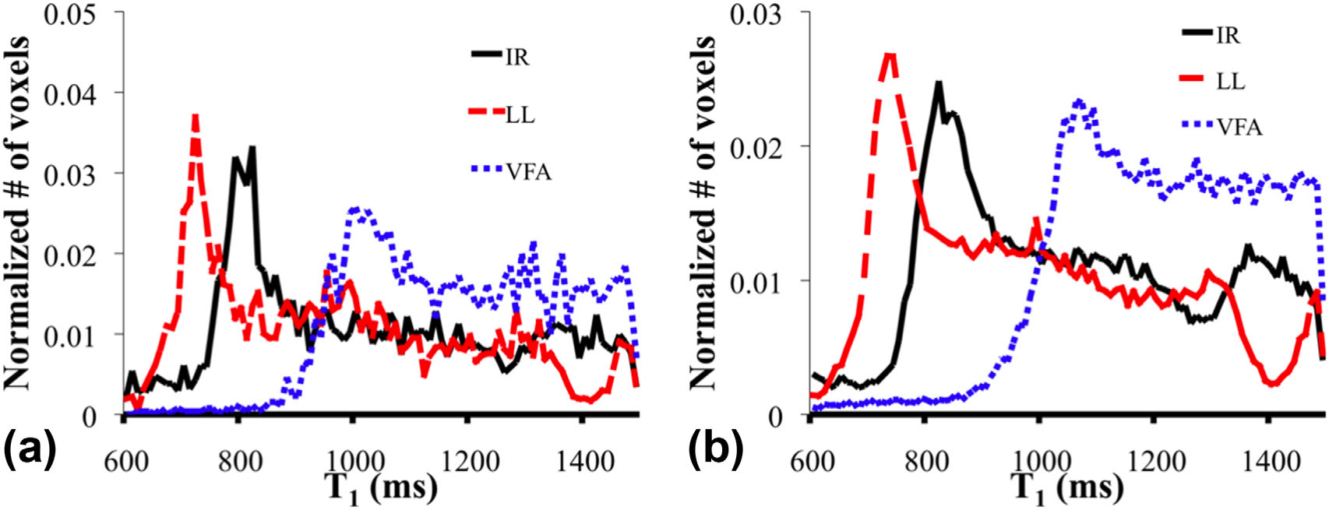

Slide 5
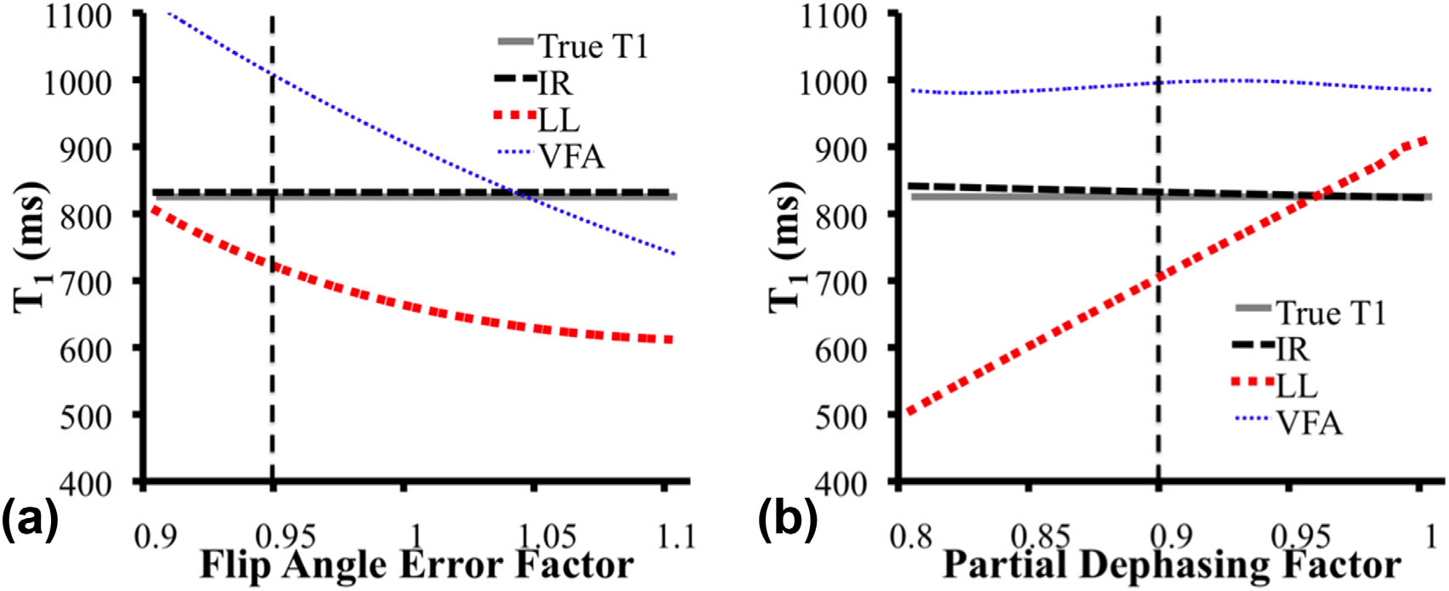

Slide 6
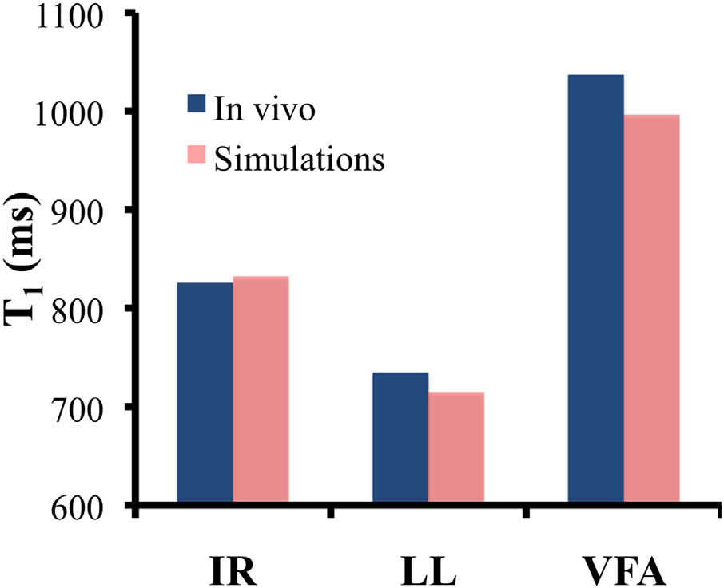

Slide 7
